Slide 1


Single Cell Sequencing
Computational Biology 1

Slide 2
Team Names
Mahmoud Sayed Youssef
Mina Nashat Fayez
Nada Essam Ali
Nourhan Ahmed Abdel-Fattah
MennaAllah Mahmoud Abdel-Raouf
Moataz Kayad Hamdy

Slide 3
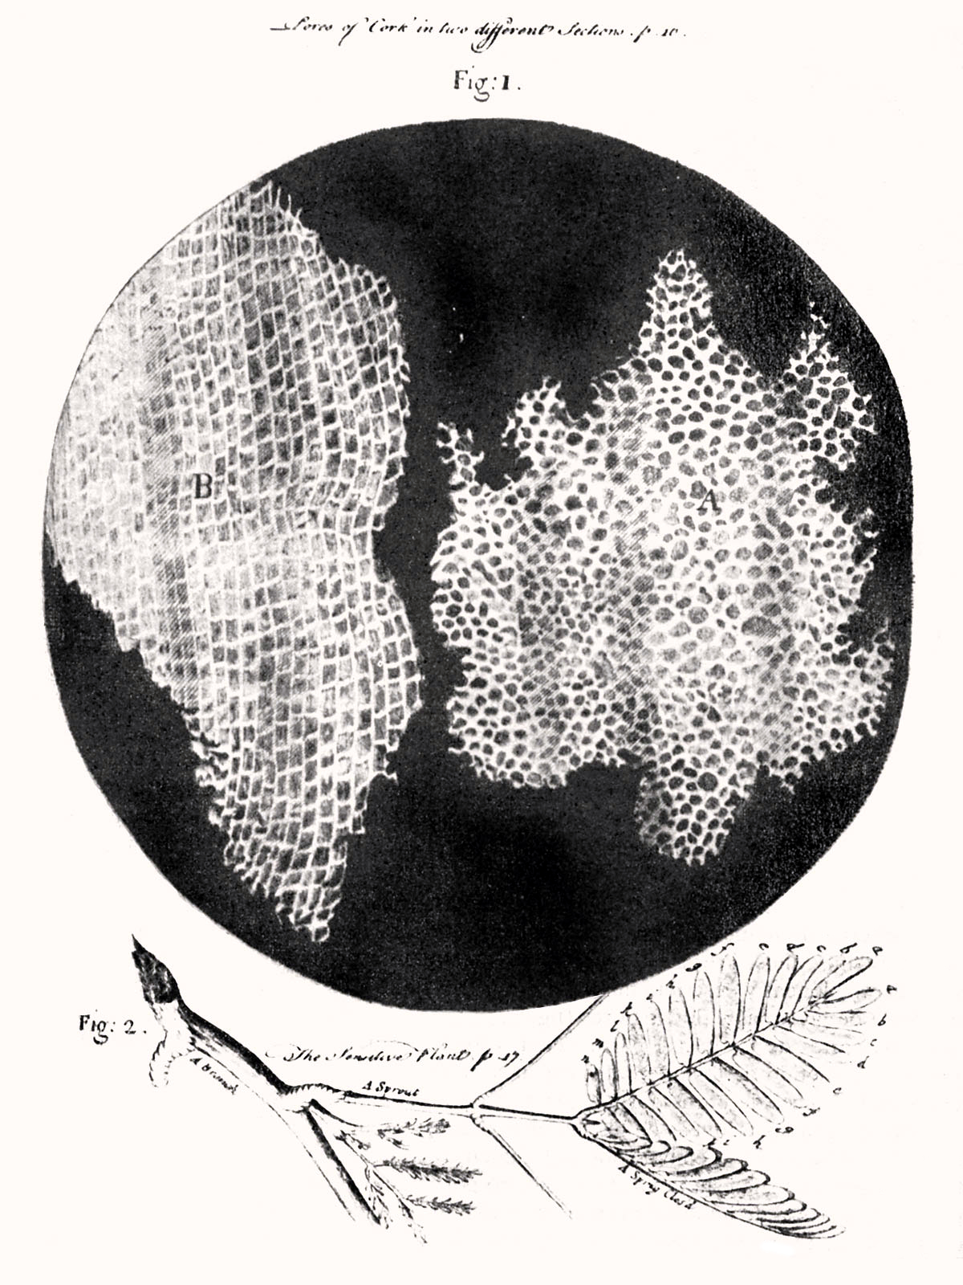
Cells are Important
Fundamental unit of life
Autonomous and unique
Interactive
Dynamic - change over time
Evolution occurs on the cellular level
Robert Hooke’s drawing of cork cells, 1665

Slide 4
Cells are Diverse
Type | Prokaryotes | Eukaryotes
Typical size | ~ 1-5 μm | ~ 10-100 μm
DNA form | Circular | Linear
DNA location | Cytoplasm | Nucleus
DNA amount | ~ .3-16 fg | ~3-300,000 fg
RNA amount | ~ 5-26,000 fg | ~ 1,000-350,000 fg

Slide 5
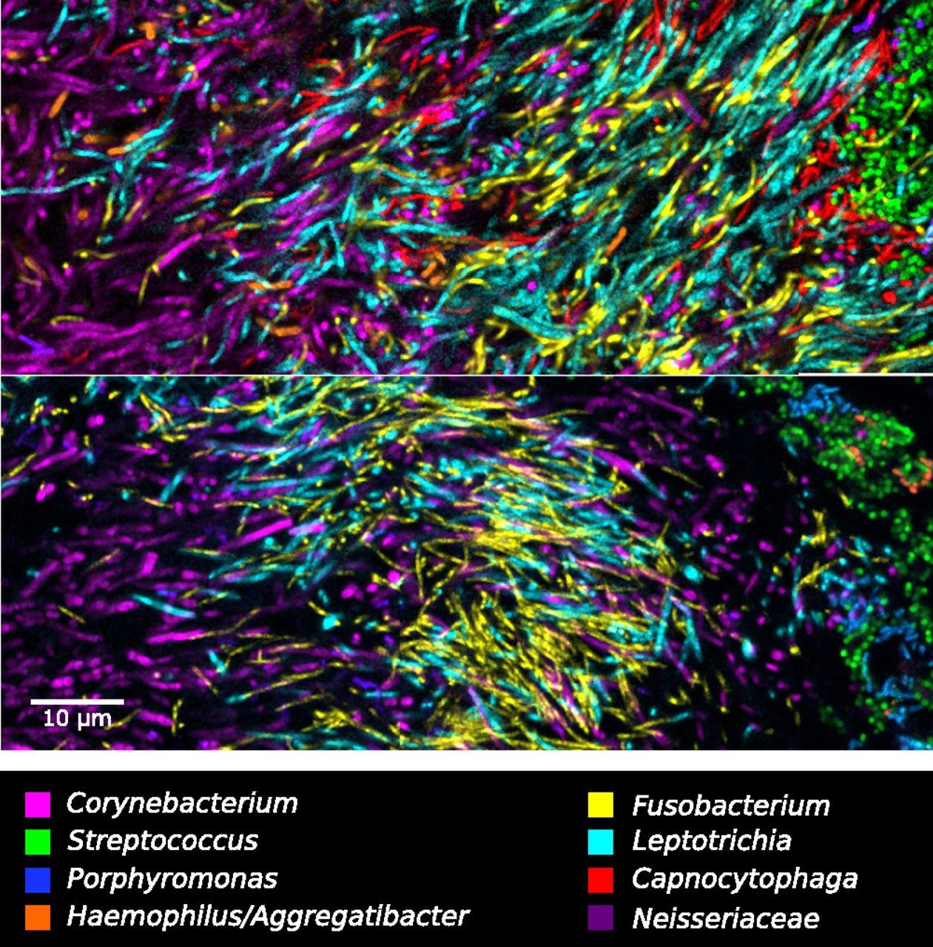
Cells are Diverse: Microbial Ecology

Slide 6
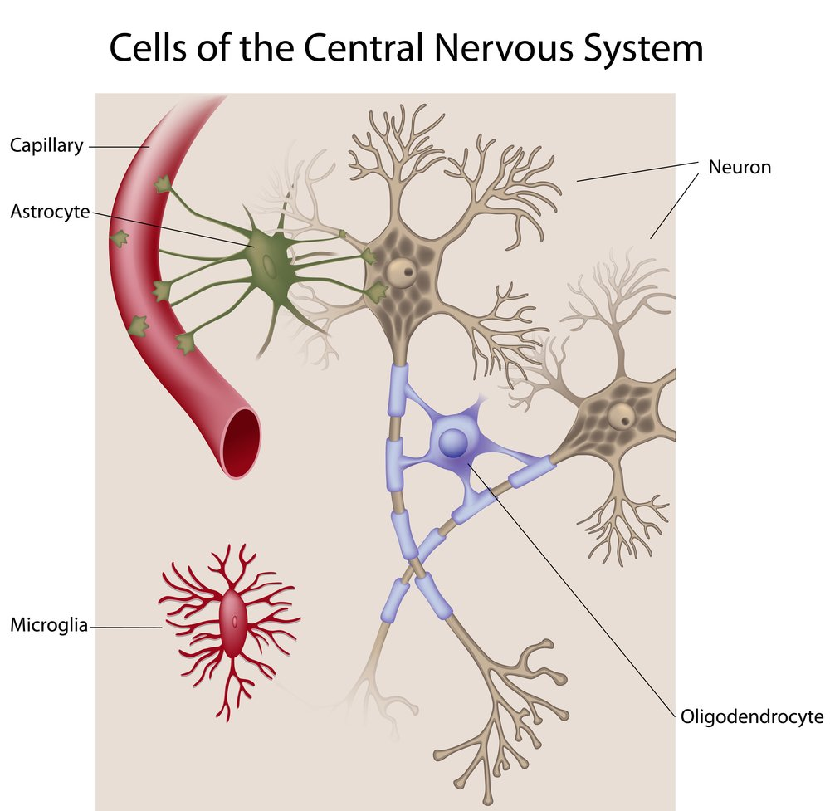
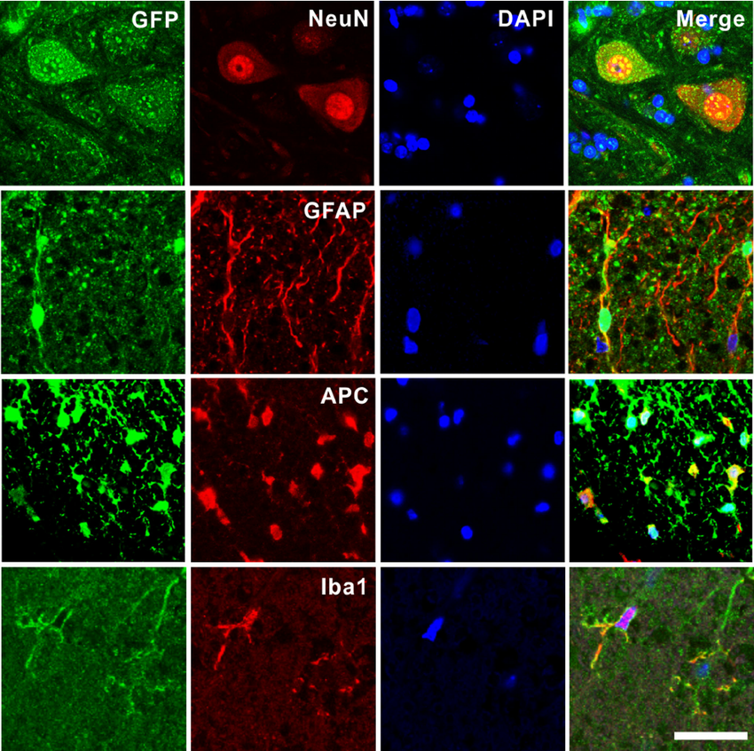
Cells are Diverse: Human Brain

Slide 7
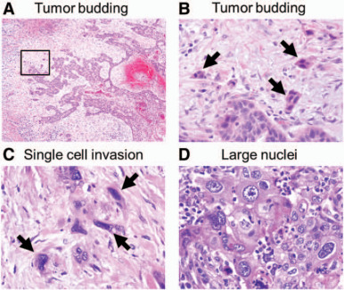
Cells are Diverse: Tumors

Slide 8
The Trees: Cells
What cell types are in a sample?
What are their proportions?
How does their transcription differ?
Which/how do specific cells respond to stimulus?
How do cells develop over time?
What is the level of mosaicism in tissues?

Slide 9
Single Cell Sequencing Flavors

Slide 10
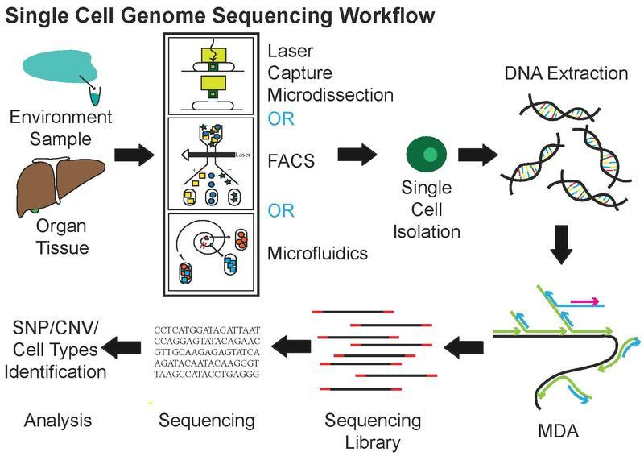
scDNA-Seq Workflow

Slide 11
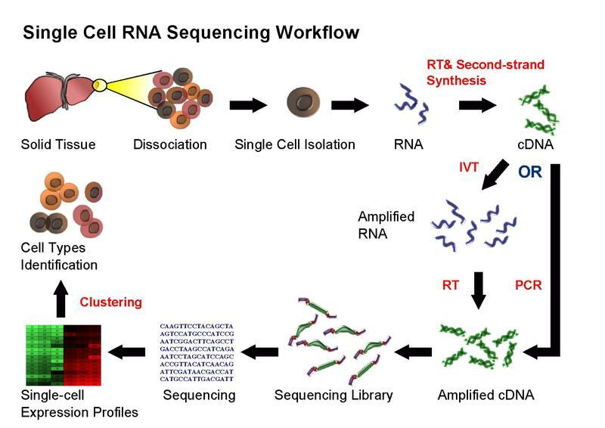
scRNA-Seq Workflow

Slide 12
Single Cell Sequencing Methods

Slide 13
Single Cell Sequencing Workflow
Dissociation of tissue, isolation of cells
FAC sorting (optional)
Nucleic acid extraction and processing
Sequencing library prep + sequencing
Analysis

Slide 14
Nucleic Acid Extraction + Processing
femto- to picograms of input material
Each cell is:
Assigned a unique DNA barcode
Read DNA By UMIs
Amplified by one of:
Reverse transcriptase (RNA)
Multiple displacement amplification (DNA)
In vitro transcription (RNA)

Slide 15
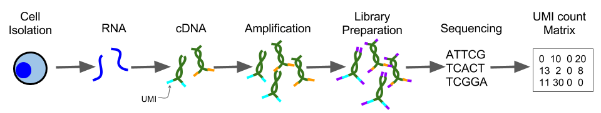
Unique Molecular Identifiers (UMIs)
Low input material may cause amplification bias
UMIs are sequences that correspond to one fragment
Sequenced reads with the same UMI are from the same fragment

Slide 16
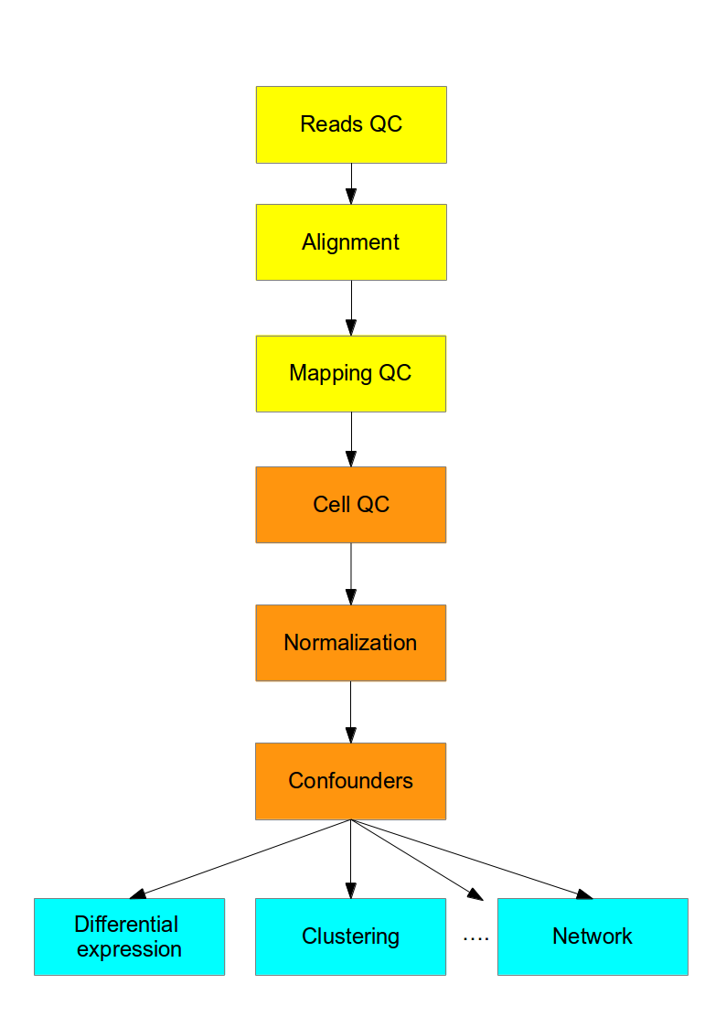
Analysis Overview
Sequence QC
UMI Collapsing
Alignment
Quantification
Normalization
DE, Clustering, etc
https://hemberg-lab.github.io/scRNA.seq.course/introduction-to-single-cell-rna-seq.html

Slide 17
Sequence QC
One sample is 100s or 1000s of cells
i.e. ~1,000 fastq files per sample
UMI-Tools - open source UMI software
Normal fastq processing and QC:
Adapter and quality trimming

Slide 18
Alignment
Standard tools and QC
Alignment: STAR, bwa, bowtie, etc
QC: RSeQC, multiqc, etc

Slide 19
scDNA-Seq Analysis
Genome assembly
Bacteria genomes
Mosaic/chimeric genomes (e.g. tumors)
Cell lineage-specific
SNPs
Structural variants

Slide 20
Quantification
STAR+htseq-count, kallisto, salmon, etc
Each sample has a different # of cells
Each cell has the same number of measurements (e.g. genes)
= (# of samples) x (# of cells) x (# of genes)

Slide 21
Analysis: de novo Clustering
Wish to identify clusters of cells using similarity of transcript abundance
Unsupervized clustering methods
Current methods:
PCA/Spectral analysis
Hierarchical or k-means clustering
Graph based

Slide 22
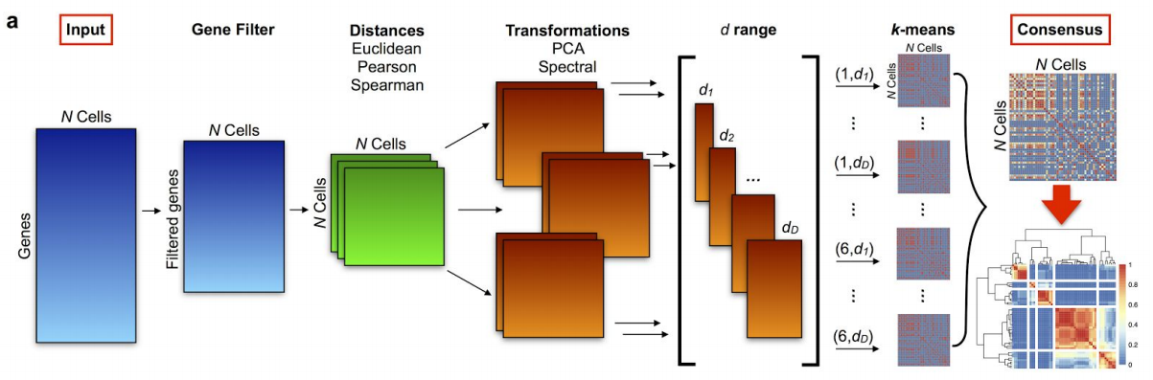
Analysis: de novo Clustering (SC3)

Slide 23
Other Analyses
Feature Selection
Eliminating “noisy” genes
Pseudotime Analysis
Inferring cellular development/change over time
Imputation
Infer expression values for “dropout” genes

